Slide 1
Operator in JAVA
Vijay Kumbhar

Slide 2
Agenda
Arithmetic Operators
Unary Operators
Assignment Operator
Relational Operators
Logical Operators
Ternary Operator
Bitwise Operators
Shift Operators

Slide 3
Operator Type | Category | Precedence
Unary | postfix | expr++ expr--
 | prefix | ++expr --expr +expr -expr ~ !
Arithmetic | multiplicative | * / %
 | additive | + -
Shift | shift | << >> >>>
Relational | comparison | < > <= >= instanceof
 | equality | == !=
Bitwise | bitwise AND | &
 | bitwise exclusive OR | ^
 | bitwise inclusive OR | |
Logical | logical AND | &&
 | logical OR | ||
Ternary | ternary | ? :
Assignment | assignment | = += -= *= /= %= &= ^= |= <<= >>= >>>=

Slide 4
++ and - - Unary Operator
public class OperatorExample{
public static void main(String args[]){
int x=10;
System.out.println(x++);
System.out.println(++x);
System.out.println(x--);
System.out.println(--x);
}}

Slide 5
~ and ! Unary Operator
public class OperatorExample{
public static void main(String args[]){
int a=10;
int b=-10;
boolean c=true;
boolean d=false;
System.out.println(~a);//-11 (minus of total positive value which starts from 0)
System.out.println(~b);//9 (positive of total minus, positive starts from 0)
System.out.println(!c);//false (opposite of boolean value)
System.out.println(!d);//true
}}

Slide 6
Arithmetic Operators
These operators involve the mathematical operators that can be used to perform various simple or advanced arithmetic operations on the primitive data types referred to as the operands. These operators consist of various unary and binary operators that can be applied on a single or two operands. Let’s look at the various operators that Java has to provide under the arithmetic operators

Slide 7
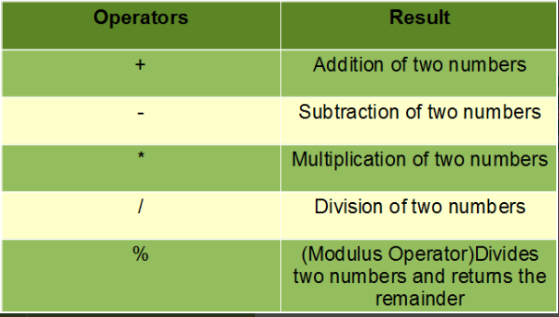

Slide 8
Assignment Operator
These operators are used to assign values to a variable.
The left side operand of the assignment operator is a variable, and the right side operand of the assignment operator is a value.
The value on the right side must be of the same data type of the operand on the left side.
Otherwise, the compiler will raise an error. This means that the assignment operators have right to left associativity, i.e., the value given on the right-hand side of the operator is assigned to the variable on the left.
Therefore, the right-hand side value must be declared before using it or should be a constant. The general format of the assignment operator

Slide 9
Thank you

